Slide 1

JUnit 5: The Rise of Jupiter

Slide 2

About me
Yaroslav Yermilov Senior Software Engineer EPAM Systems https://yermilov.github.io/ https://twitter.com/yermilov17 https://www.facebook.com/yaroslav.yermilov https://ua.linkedin.com/pub/yaroslav-yermilov/58/682/506
Worked on Big Data projects since 2012 Among other tasks, responsible for test automation Out of office is a big Groovy ecosystem fan

Slide 3
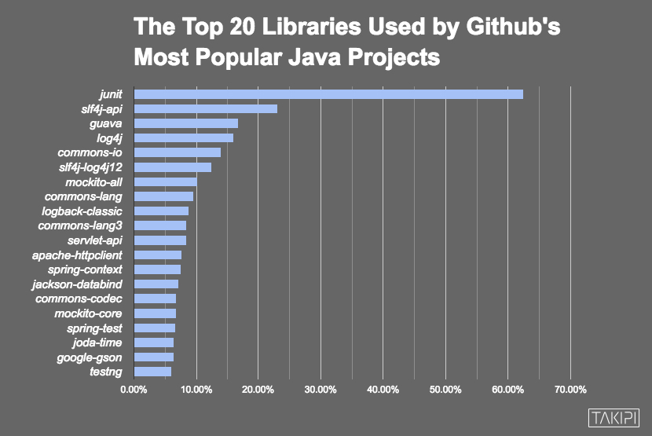


Slide 4
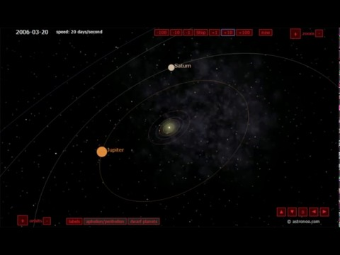

Slide 5
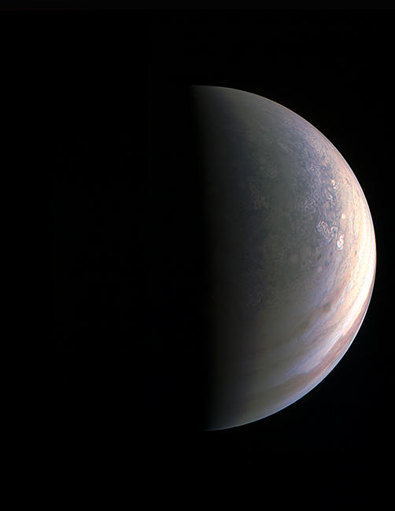


Slide 6

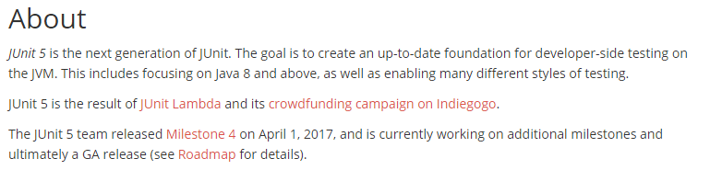

Slide 7

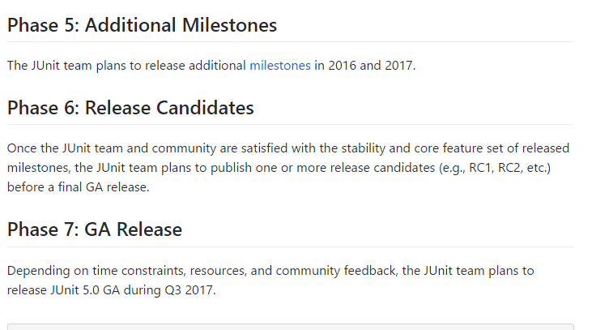

Slide 8



Slide 9


Slide 10
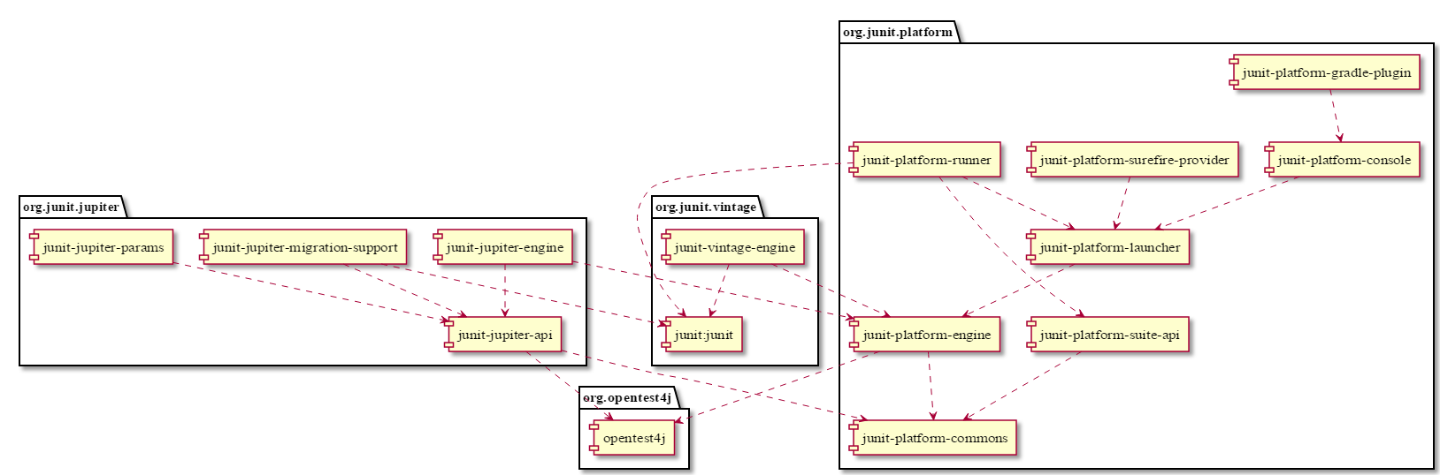

Slide 11
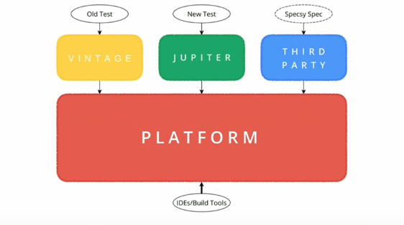

Slide 12
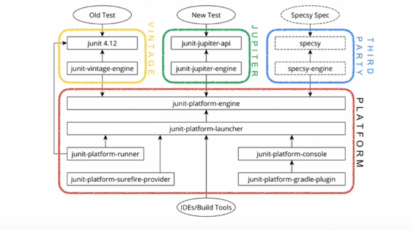

Slide 13

Links
JUnit 5: Next Generation Testing on the JVM by Nicolai Parlog @ JEEConf 2016
Deep Dive into JUnit 5 by Sam Brannen @ Devoxx 2017
JUnit 5 Home
JUnit 5 User Guide
Sources and examples @github
Examples from the demo @github

Slide 14
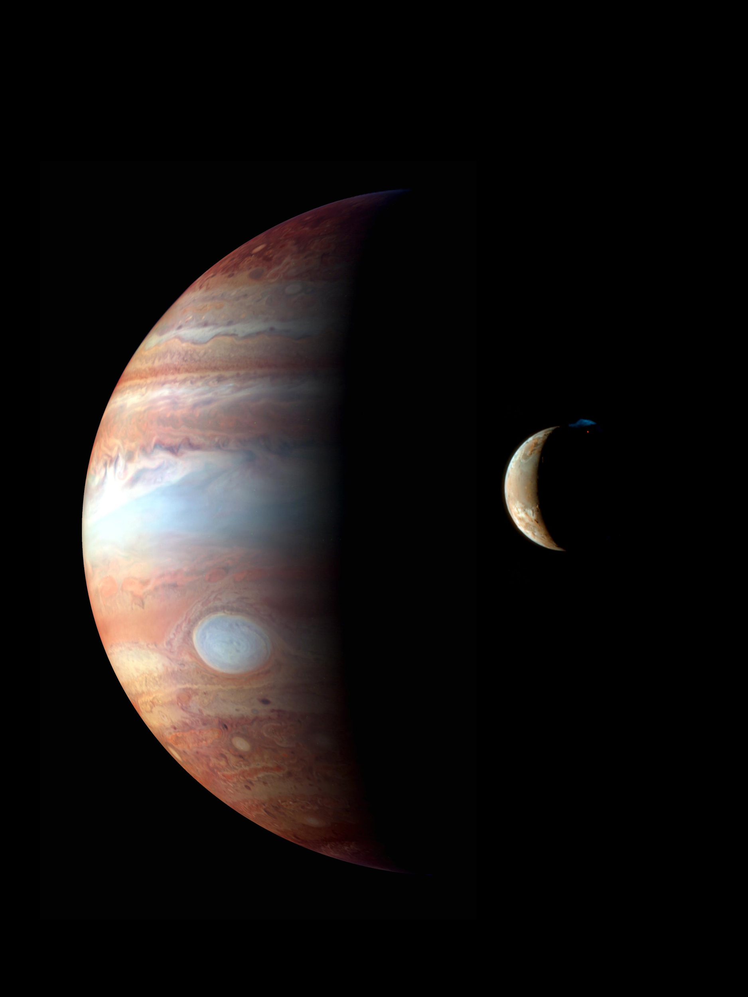
Thank you!

